Slide 1


Introduction of Management
For
Engineers

Slide 2

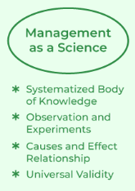
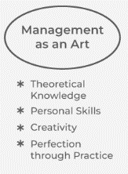

Management as :
Science or Art or Profession

Slide 3
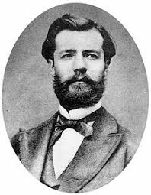
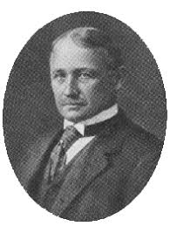
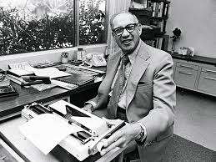
Definitions of Management
Henri Fayol: "To manage is to forecast and plan, to organize, to command, to coordinate and to control."
Frederick Winslow Taylor: "Management is the art of knowing what you want to do and then seeing that it is done in the best and cheapest way."
Peter Drucker: "management is defined as the practice of enabling groups of people with different knowledge, skills, and backgrounds to work together toward a common goal. This goal is often the company’s mission that either you or a higher-up is responsible for creating.

Slide 4

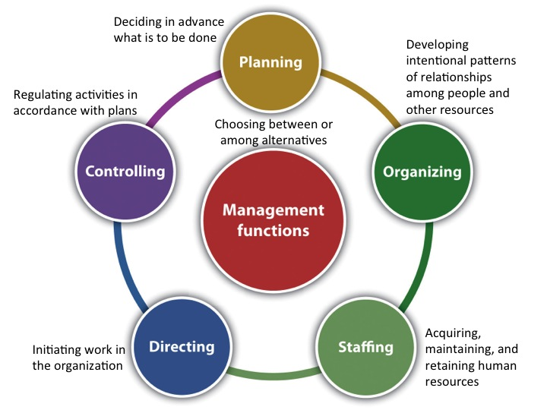

Nature & Characteristics

Slide 5







CHALLENGES TO MANAGEMENT
Innovation
And
Change Management
Social
Responsibility
Employee
Empowerment
Cultural Diversity
Quality
And
Productivity
Modern
Technologies
Globalization

Slide 6




Concept of Organization
operations manager
Marketing management
Systems Management
Project Specialist

Slide 7
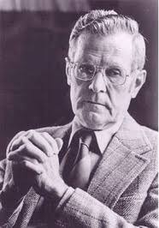
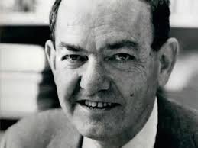
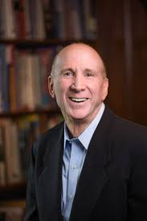
Definition of Organization
Chester I. Barnard (1938): In his book The Functions of the Executive, Barnard defined an organization as a "system of consciously coordinated activities or forces of two or more persons." This definition emphasizes the coordinated effort and conscious intention behind forming an organization.
Herbert A. Simon (1947): In Administrative Behavior, Simon described an organization as a "complex pattern of communications and other relations in a group of human beings." His definition highlights the importance of communication and relationships within an organization.
Stephen P. Robbins (1983): Robbins, in his book Organization Theory: Structure, Design, and Applications, defined an organization as "a consciously coordinated social unit, composed of two or more people, that functions on a relatively continuous basis to achieve a common goal or set of goals." This definition focuses on social units, coordination, continuity, and goals.

Slide 8




Factors influencing an Organization
Group
Human Resources
Process Manuals
Internal and External Factor
Organization consists of a number of persons who communicate with one another, often over a span of time, and who are few enough so that each person is able to communicate with all the others, not at second-hand, through other people, but face-to-face.
Organization is a coordinated unit consisting of at least two people who function to achieve a common goal or set of goals.
Organization is a set of structured Framework, Standardized operations, governance and coordination mechanism
An organization interacts with internal factors shaping its capabilities and external factors presenting opportunities and threats. Successful alignment of resources with external demands requires ongoing assessment, strategic planning, and adaptive management.

Slide 9
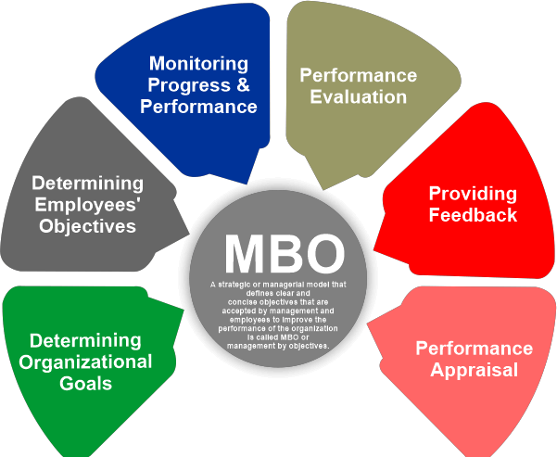
Management by Objective

Slide 10
Concept Of Administration

Slide 11
First School of Thought: Classical School
The Classical School of thought focuses on efficiency, productivity, and organizational structure. Key contributors include:
Frederick W. Taylor: Known for Scientific Management, which emphasizes time and motion studies, standardization, and specialization to improve efficiency.
Henri Fayol: Developed Administrative Theory, outlining principles of management such as division of work, authority, discipline, unity of command, and centralization.
Max Weber: Introduced Bureaucratic Theory, advocating for a structured hierarchy, clear rules, and a rational-legal authority to ensure efficiency and predictability.

Slide 12
Second School of Thought: Human Relations School
The Human Relations School emerged as a response to the limitations of the Classical School, emphasizing the social and psychological aspects of work. Key contributors include:
Elton Mayo: Conducted the Hawthorne Studies, highlighting the importance of social relations, worker satisfaction, and the informal organization.
Abraham Maslow: Developed the Hierarchy of Needs theory, suggesting that fulfilling employees' psychological and self-fulfillment needs leads to motivation and productivity.
Douglas McGregor: Proposed Theory X and Theory Y, contrasting traditional authoritative management (Theory X) with a more participative and trusting approach (Theory Y).

Slide 13
Third School of Thought: Systems and Contingency School
The Systems and Contingency School views organizations as complex systems that must adapt to their environments. Key contributors include:
Ludwig von Bertalanffy: Introduced General Systems Theory, suggesting that organizations are open systems interacting with their environment, requiring holistic management.
Joan Woodward: Developed the Contingency Theory, arguing that organizational effectiveness depends on fitting the organizational structure to the environment and technology.
James D. Thompson: Emphasized that organizations must cope with uncertainty and align their internal processes with external demands to achieve stability and effectiveness.

